Slide 1
Hill Cipher (Substitution Technique) Md. Alamgir Hossain Senior Lecturer, Dept. of CSE, Prime University alamgir.cse14.just@gmail.com

Slide 2

Hill Cipher
Hill Cipher, in the pretext of classical cryptography, follows a polygraphic substitution cipher, which means there is uniform substitution across multiple levels of blocks.
This polygraphic substitution cipher makes it possible for Hill Cipher to work seamlessly with digraphs (two-letter blocks), trigraphs (three-letter blocks), or any multiple-sized blocks for the purpose of building a uniform cipher.
Hill Cipher is based on linear algebra, the sophisticated use of matrices in general (matrix multiplication and matrix inverses), as well as rules for modulo arithmetic.
Evidently, it is a more mathematical cipher compared to others.
The Hill Cipher method was invented and developed in 1929 by Lester S. Hill, a renowned American mathematician.

Slide 3
Hill Cipher Example (Encryption )
Plaintext: “ACT”
Key: “GYBNQKURP”
To keep the example simple, here is a straightforward substitution scheme with the letter A mapped to 0, B mapped to 1, and so on and so forth.

Slide 4
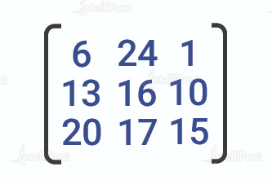

Hill Cipher Example (Encryption )
The key is “GYBNQKURP”, which in the form of an nxn matrix looks like the below:
“ACT” is written in the form of the following vector:

Slide 5
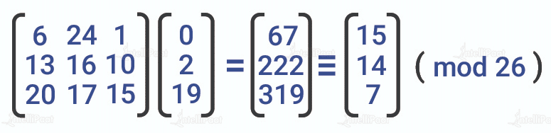
Hill Cipher Example (Encryption )
The resulting enciphered vector will be:
This results in the ciphertext of “POH”.

Slide 6

Hill Cipher Example (Decryption )
For the purpose of decryption, the ciphertext will have to be turned back into a vector. Simply, multiply it by the inverse matrix of the key matrix (IFKVIVVMI in letters). The inverse of the matrix will be:

Slide 7
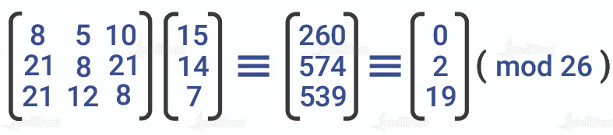
Hill Cipher Example (Decryption )
For the previous Ciphertext ‘POH’, multiplying it with the inverse matrix gives:
The output vector gives back ‘ACT’.

Slide 8

Hill Cipher Example-2
Encrypt the plaintext “attack” using Hill cipher for the given key =$\left[\begin{aligned}2 3 \\ 3 6\end{aligned}\right]$
Since the key is a 2x2 Matrix, plaintext should be converted into vectors of length 2. So, ${\left[\begin{aligned}a \\ t\end{aligned}\right]}^{2×1}$ ${\left[\begin{aligned}t \\ a\end{aligned}\right]}^{2×1}$ ${\left[\begin{aligned}c \\ k\end{aligned}\right]}^{2×1}$

Slide 9
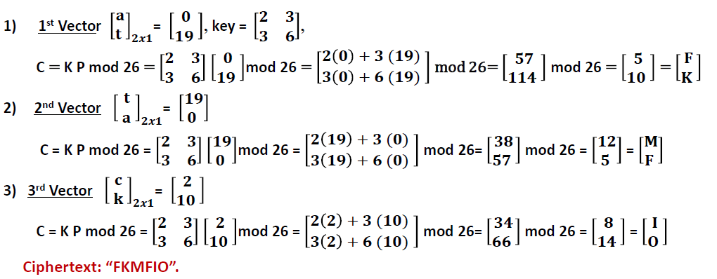
Hill Cipher Example-2 (Encryption)

Slide 10
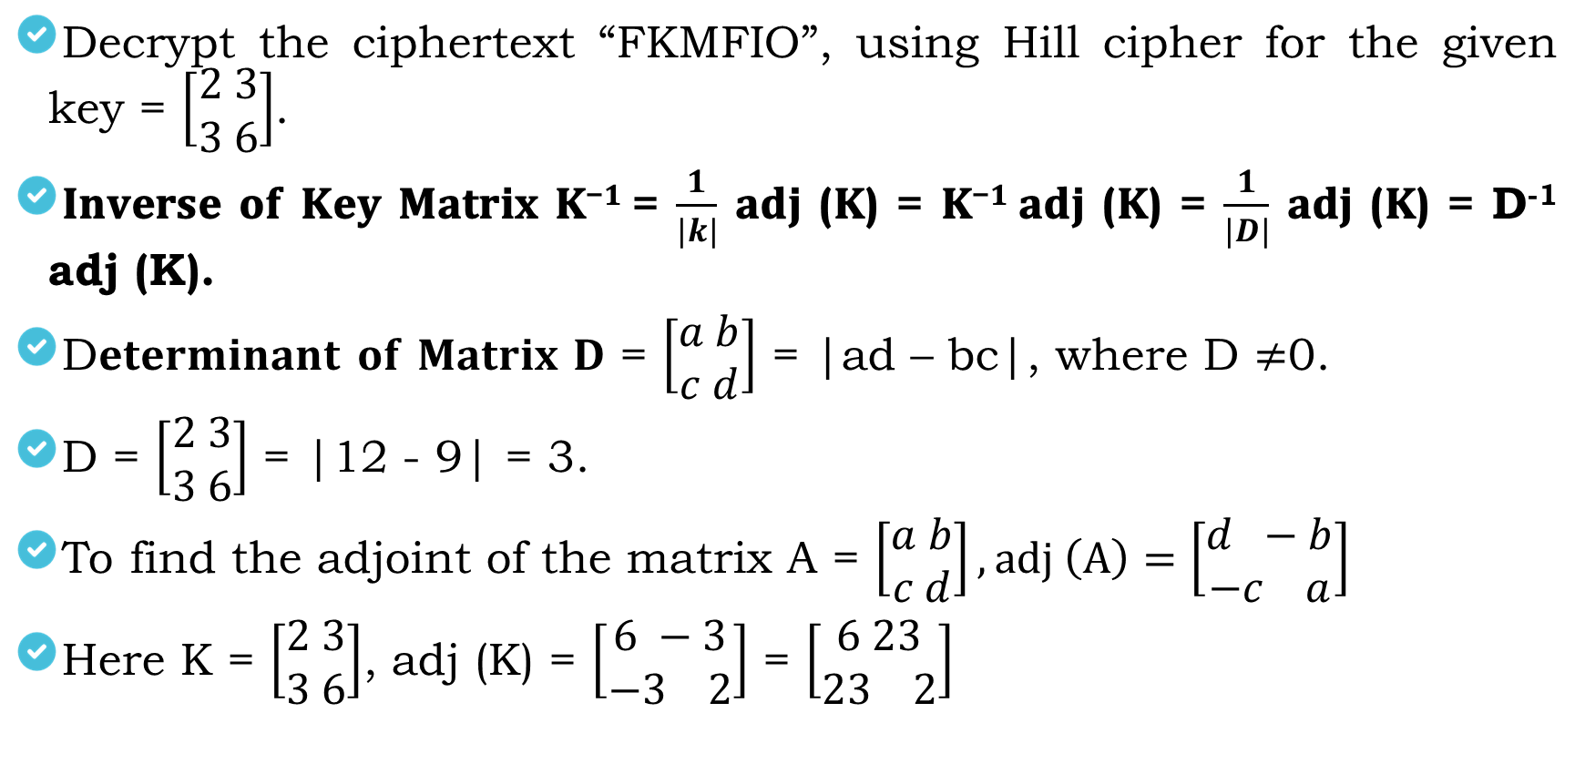
Hill Cipher Example-2 (Decryption)
Decrypt the ciphertext “FKMFIO”, using Hill cipher for the given key = $\left[\begin{aligned}2 3 \\ 3 6\end{aligned}\right]$.
𝐈𝐧𝐯𝐞𝐫𝐬𝐞 𝐨𝐟 𝐊𝐞𝐲 𝐌𝐚𝐭𝐫𝐢𝐱 𝐊^{−𝟏} = $\frac{1}{|k|}$ 𝐚𝐝𝐣 (𝐊) = 𝐊^{−𝟏} 𝐚𝐝𝐣 (𝐊) = $\frac{1}{|D|}$ 𝐚𝐝𝐣 (𝐊) = D⁻¹ adj (K).
D𝐞𝐭𝐞𝐫𝐦𝐢𝐧𝐚𝐧𝐭 𝐨𝐟 𝐌𝐚𝐭𝐫𝐢𝐱 𝐃 = $\left[\begin{aligned}a b \\ c d\end{aligned}\right]$ = |ad – bc|, where D $≠$0.
D = $\left[\begin{aligned}2 3 \\ 3 6\end{aligned}\right]$ = |12 - 9| = 3.
To find the adjoint of the matrix A = $\left[\begin{aligned}a b \\ c d\end{aligned}\right], adj \left(A\right)=\left[\begin{aligned}d −b \\ −c a\end{aligned}\right]$
Here K = $\left[\begin{aligned}2 3 \\ 3 6\end{aligned}\right]$, adj (K) = $\left[\begin{aligned}6 −3 \\ −3 2\end{aligned}\right]$ = $\left[\begin{aligned}6 23 \\ 23 2\end{aligned}\right]$

Slide 11
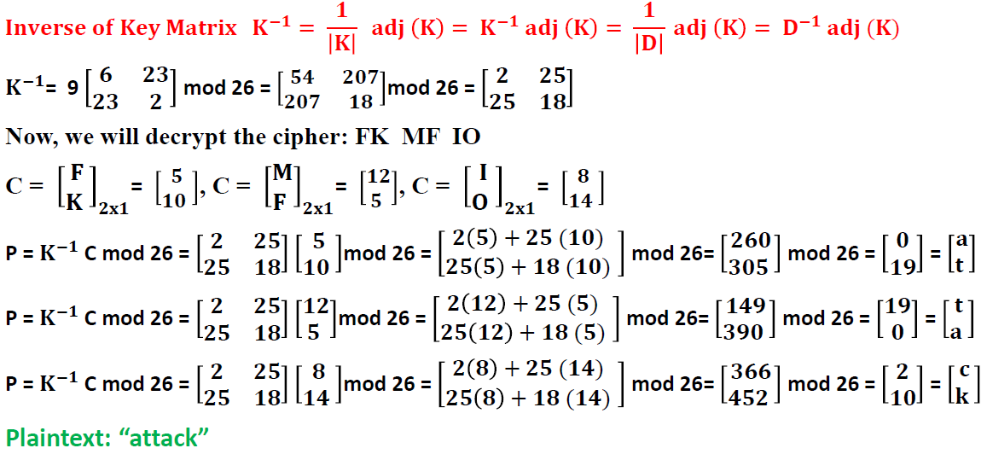
Hill Cipher Example-2 (Decryption)

Slide 12
Hill Cipher Example (Notes )
Encryption and decryption both play a crucial role in understanding the use of Hill Ciphers in general. It is important to understand that any possible matrix in the system does not represent a key matrix. Cipher decryption instead requires an inverse key matrix.
The determinant method can determine whether the inverse exists or not. If the value of the determinant is 0 or shares a factor other than 1, it means that the matrix does not have an inverse. As a result, one will have to find or choose a different key matrix for decryption.
A usable or key matrix with non-zero determinants must have a coprime component directly to the overall length of the alphabet to be able to extract results from a cipher.

Slide 13
Advantages of Hill Cipher
It perfectly conceals single-letter frequencies.
3×3 Hill Ciphers are extremely effective when it comes to hiding both single-letter and two-letter frequency information.
It is highly strong against attacks made on ciphertext except if the attack is through a known plaintext.

Slide 14
Security Aspects of Hill Cipher
When dealing with 2×2 matrices, Hill Cipher is easily solvable. But when it comes to modern cryptography solutions that have 256 combinations of numbers, Hill Ciphers can be fairly weak.
Unfortunately, a higher level of matrix multiplications doesn’t do anything to add more security to the system. It can, however, complement diffusion on mixing with non-linear operations. Modern advanced encryption methods like AES use different diffusion to add further security to their system.

Slide 15
Thank You

